Slide 1
PEST MONITORING SYSTEM
Name: S MOHANA PRIYA
Admn no. 21JE0792

Slide 2
INTRODUCTION
In India, the agricultural economic loss is mainly due to insects and pests. Therefore, pesticides are widely used by farmers to control weeds, insects and plant diseases. Excess usage of pesticides is not only an adverse for the environment but also for human and economy of the nation.
Every crop has its own type of pests and problems and different pest control management system. Focusing on one of them i.e. plantation crops like cotton and saffron I have developed an IoT based solution to one of the problems faced by farmers involved in cotton plantation.

Slide 3
Understanding the Problem
The plantation of seeds takes place in a row column methodology with seeds placed in the ground at a specified distance. Some of the seeds do not germinate or are dug out and eaten by the pests like rats and rabbits or insects in the fields which leads to loss in case of heavier infestation at a particular place, specially for plantation crops. Traditionally the farmers walk around in their fields few days after germination and re seed the places where there is no germination or growth.

Slide 4
Idea and Approach
The basic approach is to get drone images of the field then superimposing with the coordinate system. Integrating it over the WiFi so the farmers can get the pictures of their field by logging into their id and locate the positions of lower density of crops , they can just check such places for ungerminated seeds and based on coordinate system superimposed on the image. In the initial stages of the plan I also intended to monitor the entire area to figure out the seeds that might have been destroyed by the pests even before germination, but I could not think of an idea to make it economically and strategically feasible.

Slide 5
Idea And Approach
The secondary part of the model also includes the PIR sensors activated after dark to monitor the hedges for locating pest infestation, so that the place could be cleared up or barricaded.
The proposed system uses infrared sensor (PIR) to detect the presence of insects and other pests by the heat radiated by their body.

Slide 6
How will it help the Farmers ?
The main purpose of this project was to develop a guidance or helping system for the farmers to reduce their workload at the same time help them in optimization of the output. This will save their time and energy which they can spend on other economic boosting activity.
This will also help them in controlling pests and reduce the expenditure in pest control system they might use.

Slide 7
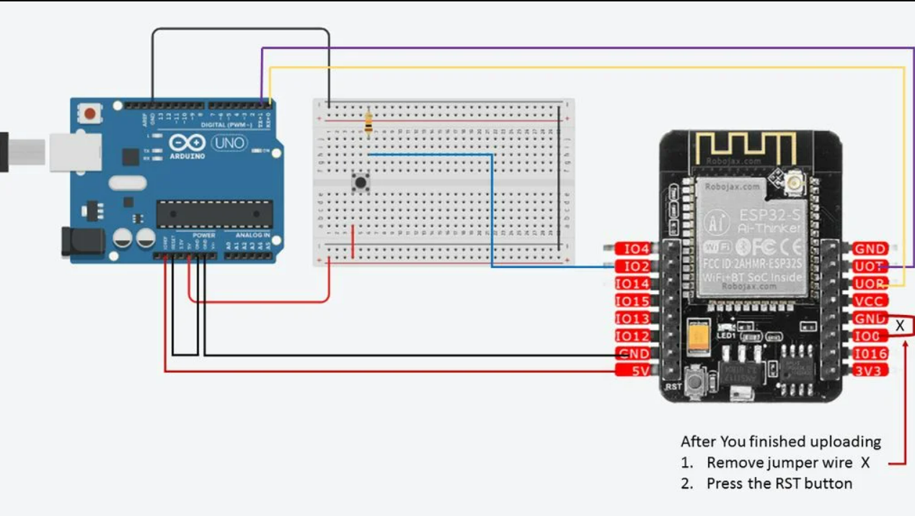
CONNECTION AND CIRCUIT DIAGRAM

Slide 8
THANK YOU

